Slide 1
Secure Password Manger
By- Prateek J

Slide 2
Requirements
Hardware
RAM:4GB and Above
ROM:256 GB
Software
VS Code Editor
Python 3.12
Packages: tkinter, smtp, random, cryptography,etc.,
MySql Workbench

Slide 3
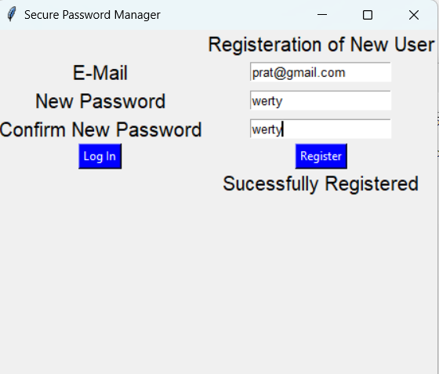
Preview – New User

Slide 4
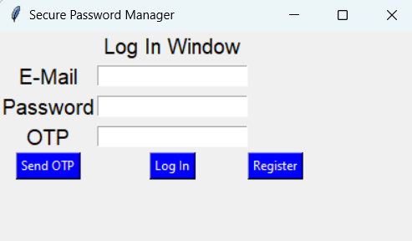
Preview – Log In

Slide 5
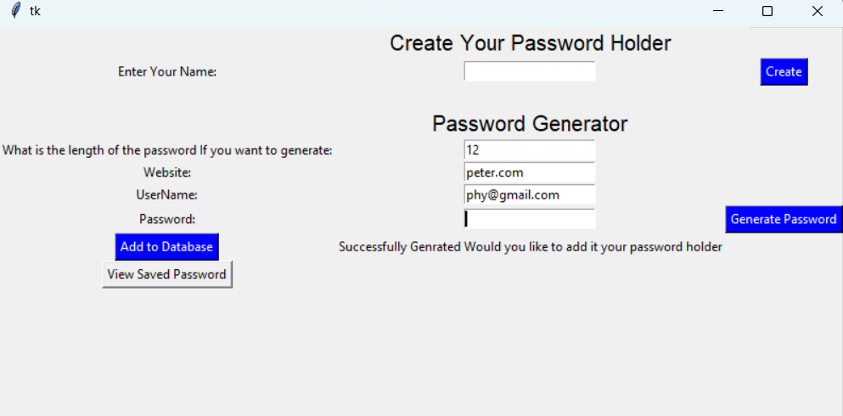
Preview – Database Operation

Slide 6
Conclusion
Secure Password with just simple implantation
Easy to use for the user

